Slide 1

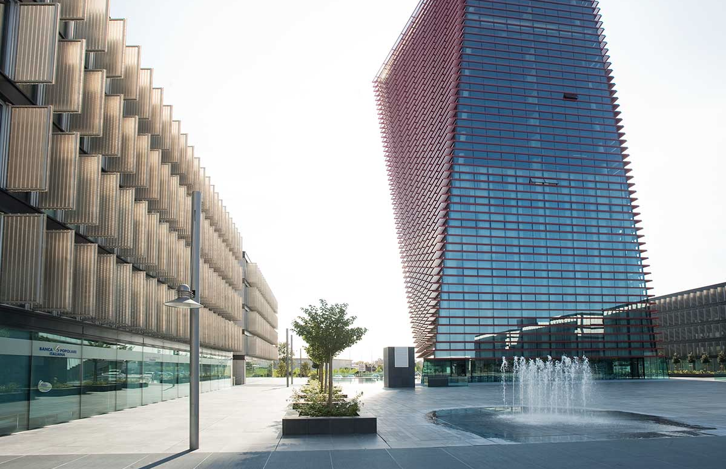

Italian Company, founded in 1998
Headquarters in Padua, Italy
Marco Pirini
R&D Director
Notes:
The devices you see here are a family of modular, medical-grade devices that permits a very wide range of rehabilitation activities fin a variety of domains and for alarge variaty of patients in the clinical facility, in the rehab gymn, and at home

Slide 2

Since 1998 Khymeia creates breakthrough technologies for rehabilitation and telerehabilitation based on virtual reality.
Born at MIT as a spin-off from research by Institute Prof. Emilio Bizzi, Chairman of Khymeia’s scientific committee.
Many fields of application:
Neurological – Orthopedic – Cardiorespiratory – Functional oncologic
Pursuing clinical excellence through national and international research projects.

Slide 3

















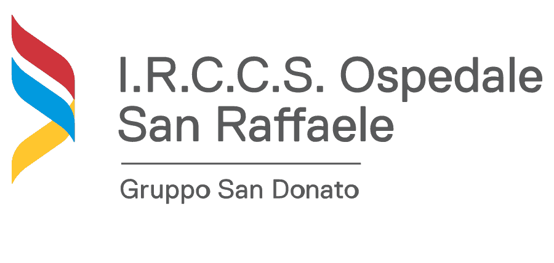



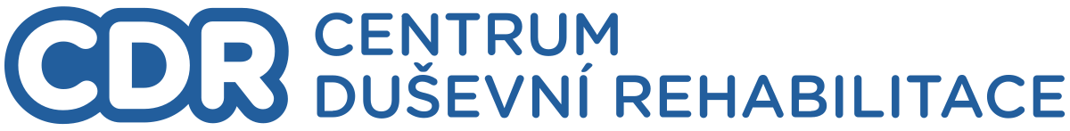

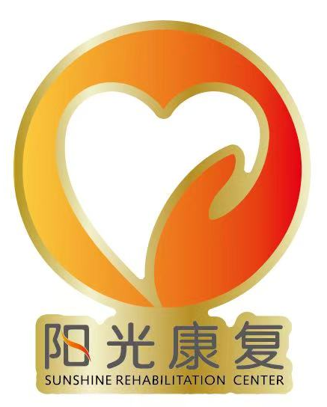
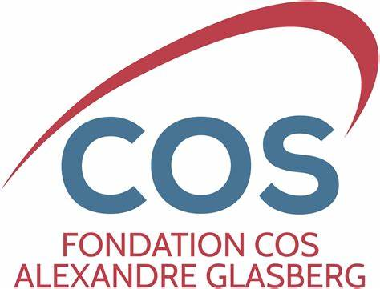







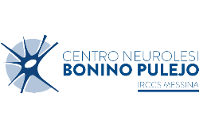



Our partners.
And many others.
Notes:
Khymeia is technology partner of RIN (Rete Italiana Neuroscienze) that is the Italian Neuroscience Network of the Ministry of Health, for the most important project worldwide of home teleneurorehabilitation with the participation of 18 IRCCS (the most important hospitals in Italy), activated in 2017 for «Development and implementation of a Italian Network of Telerehabilitation for the assistential continuity».
Khymeia is technology partner of RETE IDEA (Associazione Rete Italiana Dell’Età evolutivA, Italian network of the developmental age), the network of the Italian Ministry of Health that connects the 12 most advanced pediatric hospitals (IRCCS) and specialists to advance both research and care. Khymeia is a partner in its pediatric telerehabilitation project, leveraging technology for innovative treatments.
Main partners: IRCCS, local health authorities, hospitals, clinical centers (private and public), PT centers

Slide 4



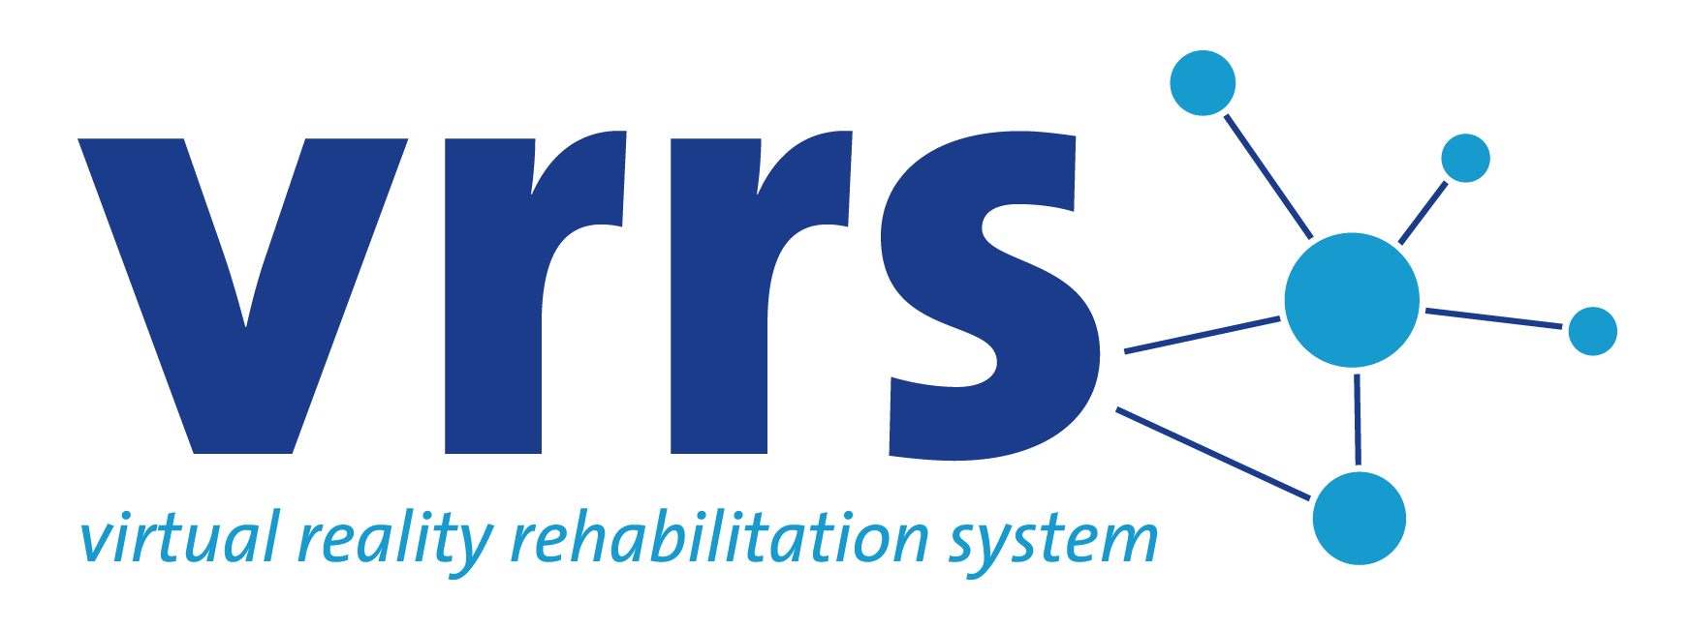

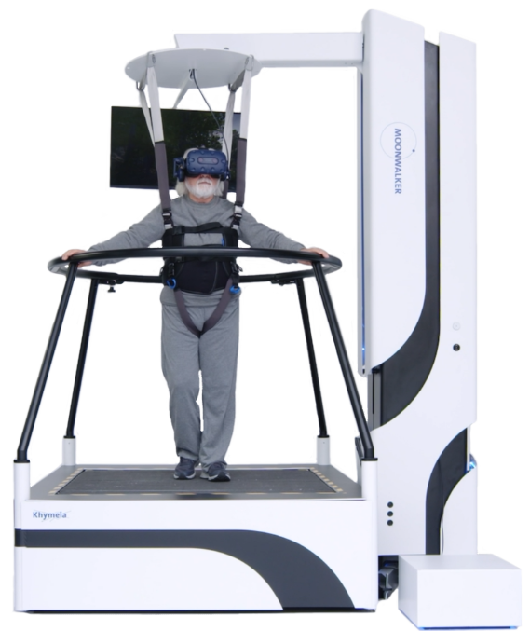
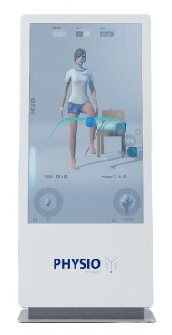
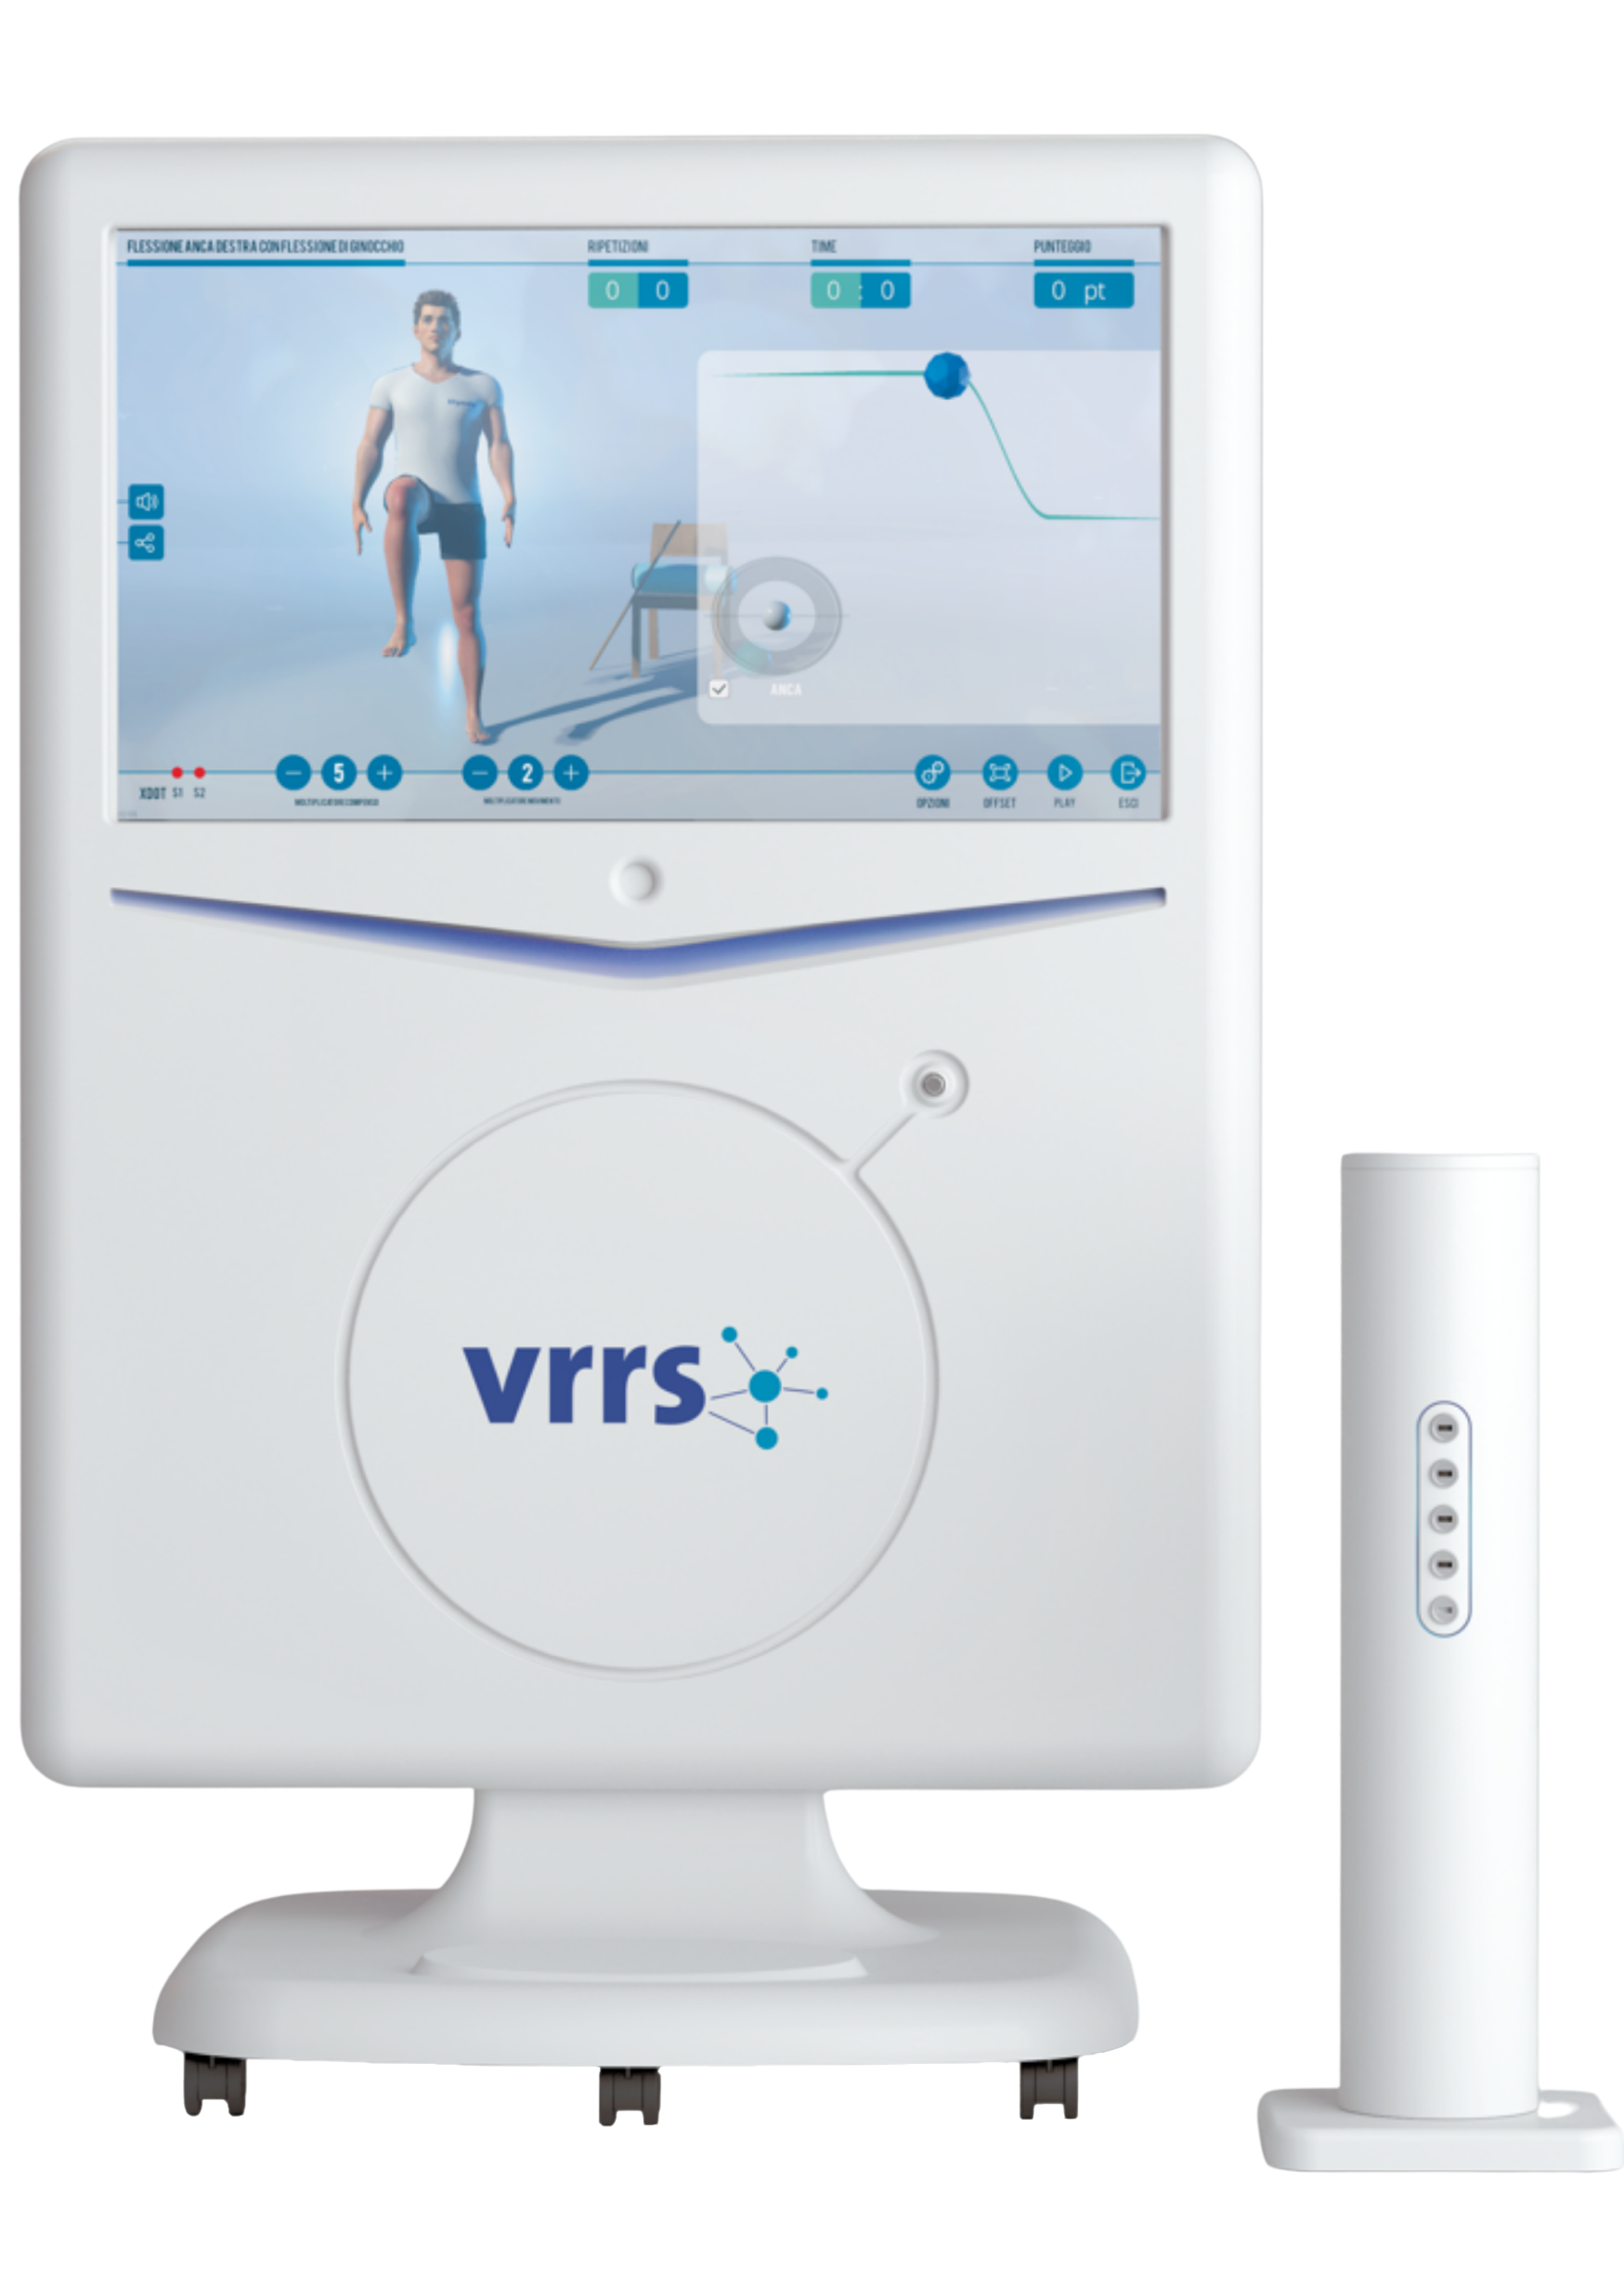
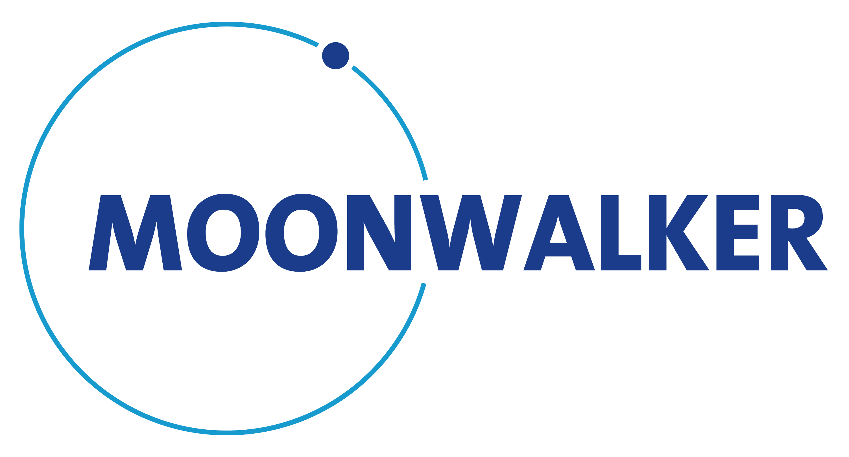
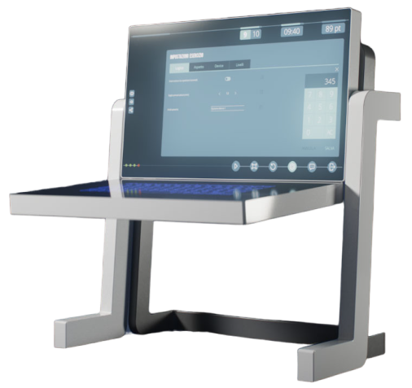
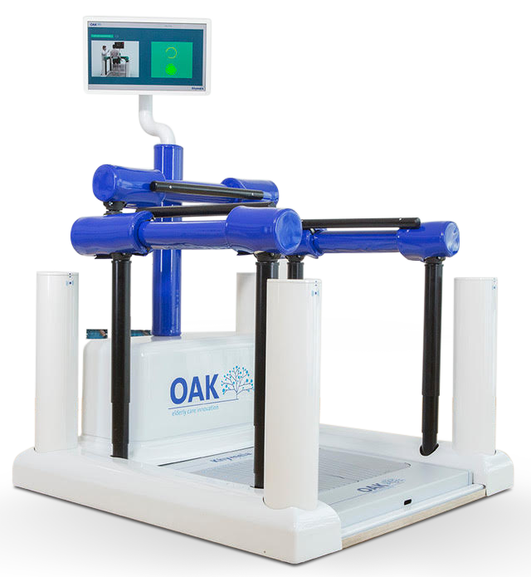




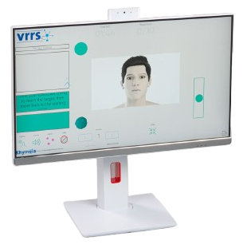
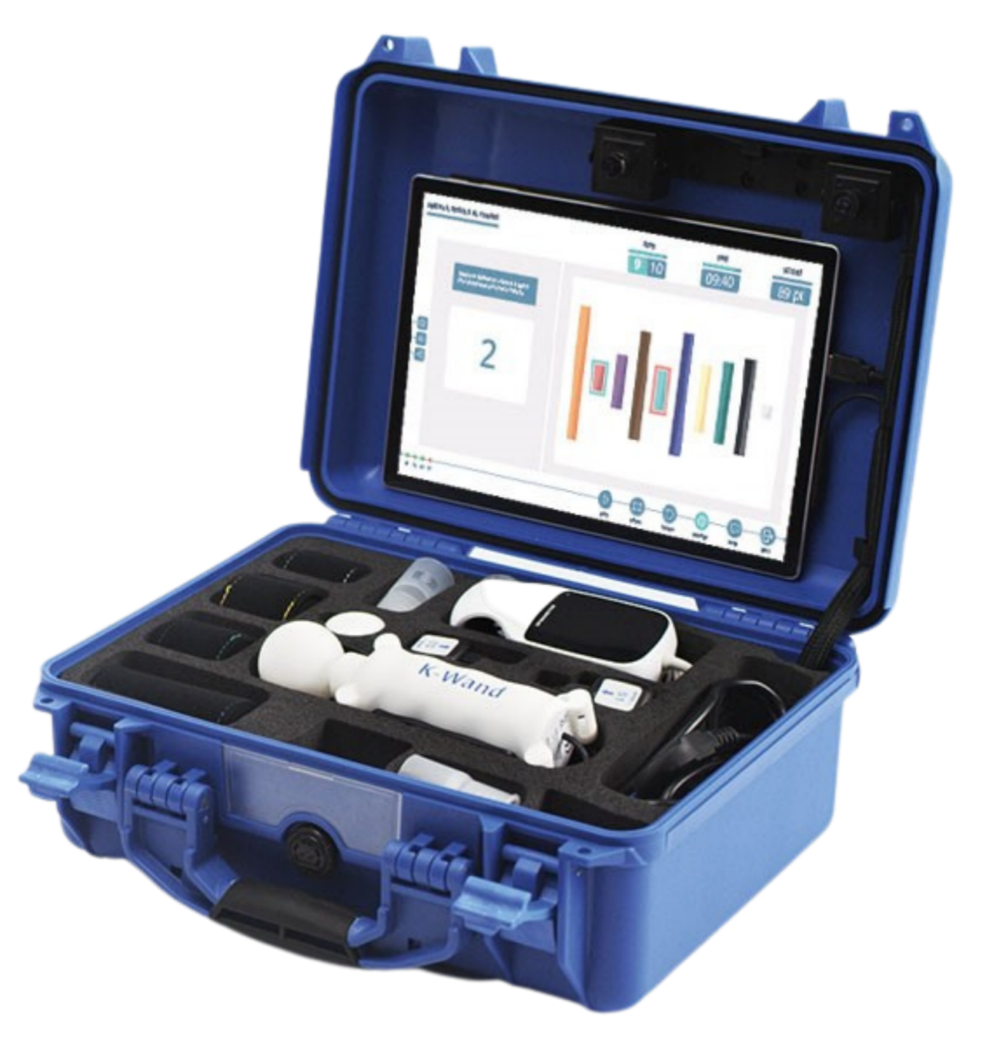
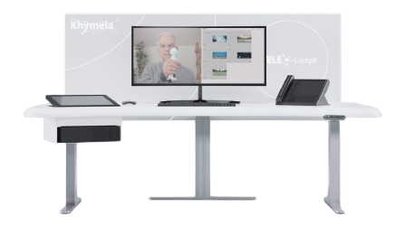
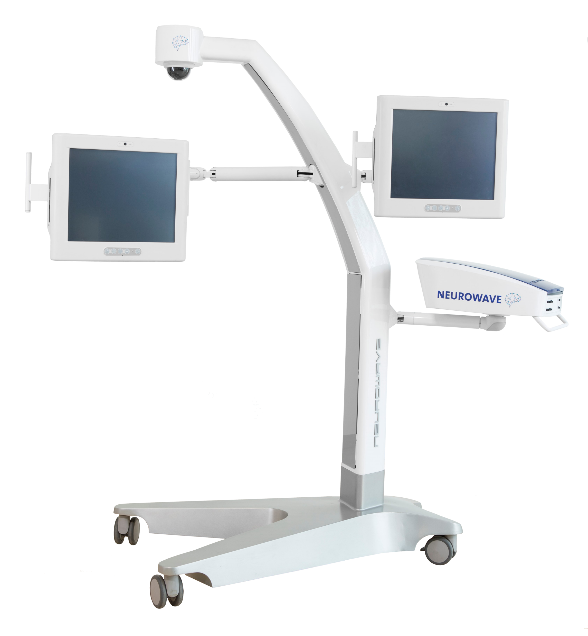
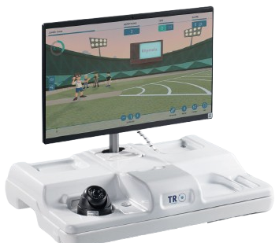


MEDICAL DEVICE CLASS I - PATENTED
^{VRRS Ecosystem.}
^{Synergic 360° rehabilitation.}
Intensive clinical use.
The most complete
VR rehabilitation system
in the world.
Interaction beyond all limits.
^{Falling risk prevention.}
Cognitive and speech therapy rehabilitation.
TELEREHAB
The quality of the clinical excellence at home.
^{Contact seeker.}
Pocket rehab.
Notes:
No sensible identification data on the patient’s device
Data encrypted and protected on cloud backend and during transit
Role-based permissions by facility, with customizable privacy settings per organization
Measures to ensure resilience, backup, and availability of data and applications (art 32, 33, 34 GDPR).
Full adherence to GDPR Arts. 12-23 for data access and management
Ready to be compliant to any local privacy

Slide 5
^{All devices are:}
• available for adults and children
^{• available in all languages}
^{• connected to the Kloud}
^{• MDR compliant}
^{• GDPR compliant}
^{• Medical Class I certified}

Slide 6
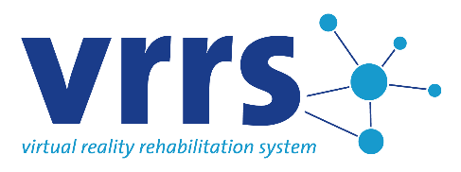
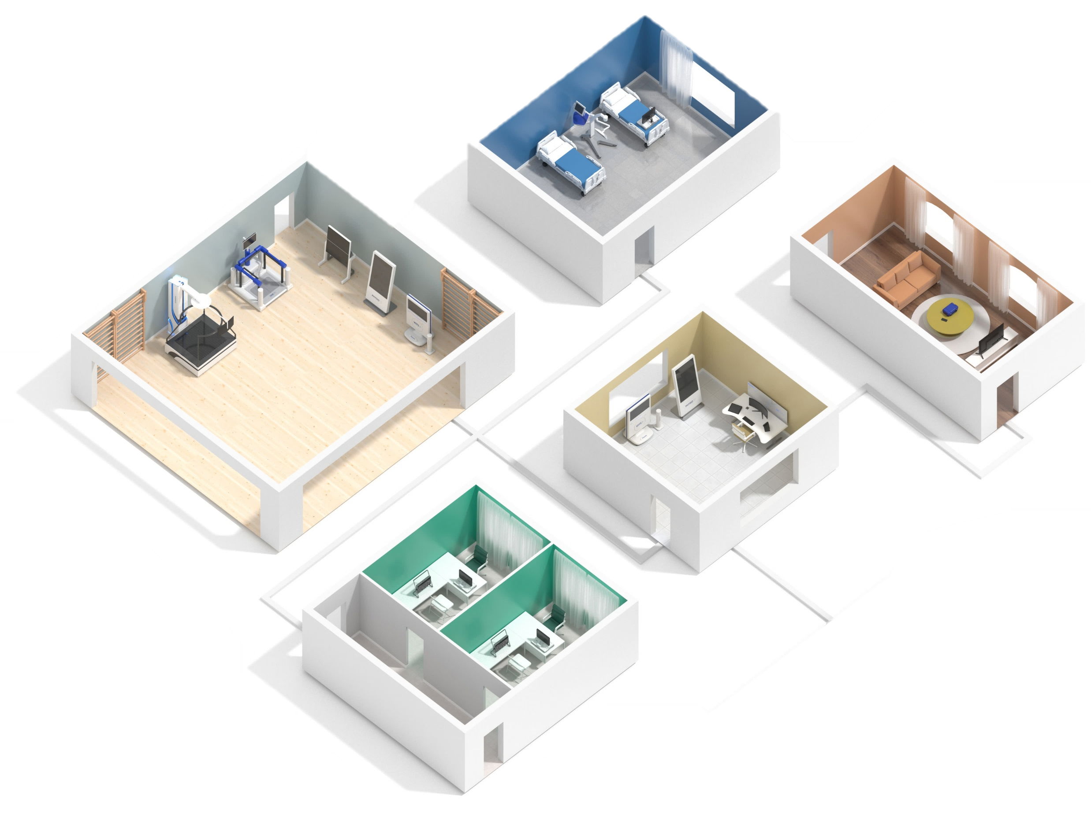
A complete follow-up from hospitalization to home.
.
Doctors.
Caregivers.
Physiotherapists.
CURRENTLY:
200+ installations; 1500+ home rehab stations
Occupational therapists.
Neuropsychologists and speech therapists.
Notes:
All the devices of the VRRS ecosystem can be implemented in different places within the same hospital or in different hospital structures belonging to the same group, putting them in communication and network connection with the central Kloud.

Slide 7


Working in different domains.
.
^{NEUROLOGIC AMBIT}
^{ORTHOPEDIC AMBIT}
VRRS was initially developed for neurological rehabilitation, more specifically for post-stroke patients, however the field of action was immediately expanded to cover almost all neurological rehabilitation domains.
In close correlation with neurological rehabilitation, expertise has also been developed in orthopedic rehabilitation, expanding the range of modules to cover all physical movements of the body.
^{FUNCTIONAL ONCOLOGIC AMBIT}
^{CARDIO-RESPIRATORY AMBIT}
VRRS is now also available with motor, cognitive and postural modules for cancer patients in the clinic and at home.
VRRS is now also available with cardiorespiratory modules, which are also effective in the case of post-COVID19 treatments to lower the effects of the virus in the long term.

Slide 8















Configurable with many rehabilitation modules.
.
ª
^{B}
^{ü}
^{Cognitive}
^{Speech Therapy}
^{Phonation}
^{NeuroMotor Skills}
^{Facial Movements}
^{Cardiorespiratory}
^{Cervical Spine}
^{Motor Skills}
^{Motor Skills Evaluations}
^{Postural}
^{Postural Evaluations}
^{Evaluation scales}
^{Monitoring}
^{Immersive VR}
^{EMG}
^{tDCS}
^{Force}
^{Grip}
^{Hand & Wrist}

Slide 9
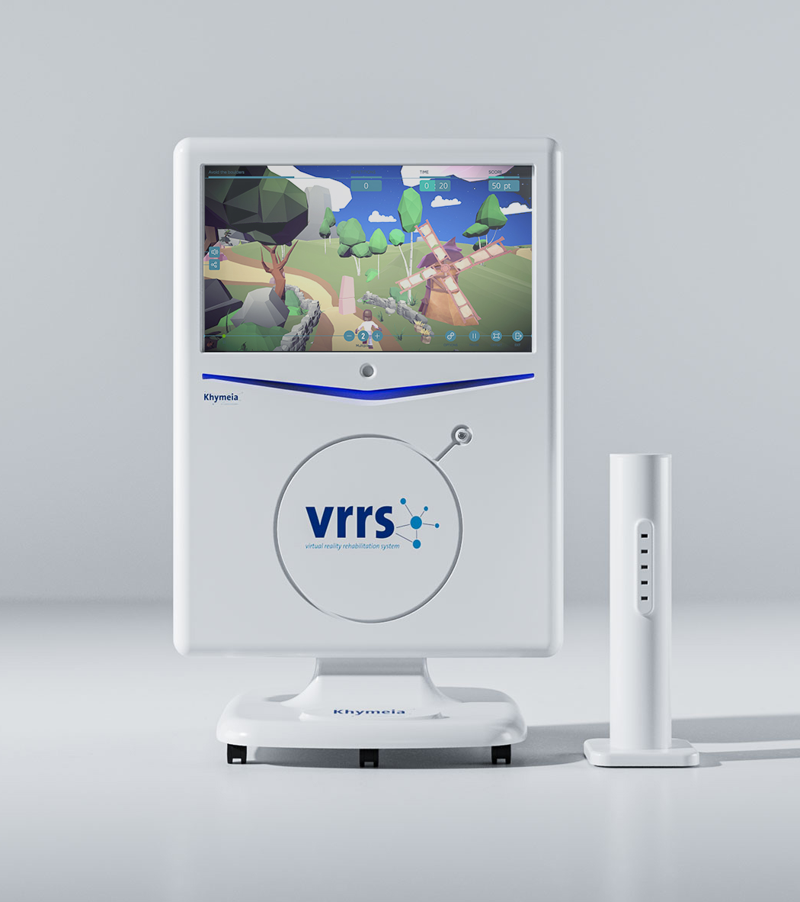

VRRS
Innovative and unique ecosystem for rehabilitation and tele-rehabilitation, VRRS is the most scientifically and clinically tested virtual reality system in the world.
VRRS includes more than 1000 clinician-designed and clinically tested activities with the possibility for the therapist to create new ones.
The VRRS offers 18 different rehabilitation modules with a single central unit, allowing the therapist to treat the patient's multiple pathologies during the same session.
Every VRRS module has a dedicated sensor, delivering precision, ease of use, and reliable data collection.

Slide 10
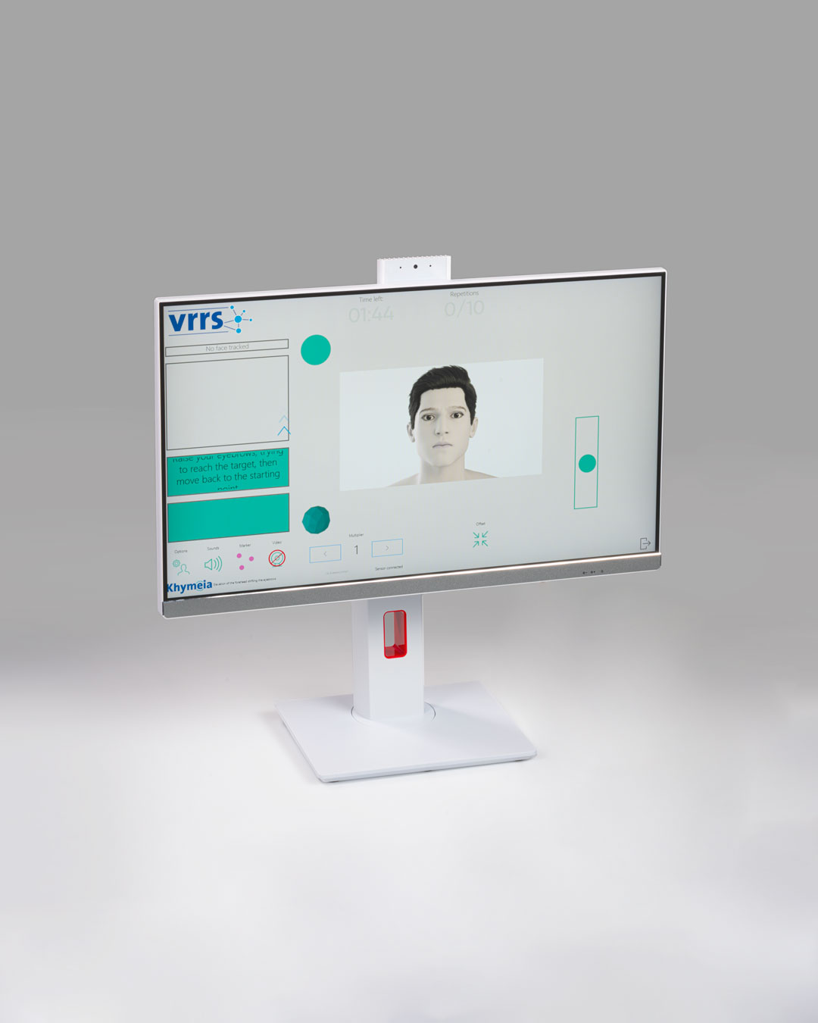

COMPACT
VRRS COMPACT is the ideal solution for cognitive and speech therapy rehabilitation.
Powered by the VRRS operating system, COMPACT delivers the full potential of VRRS methodology in a space-saving design.
With its compact footprint yet fully immersive experience, VRRS COMPACT is perfectly suited for medical practices and clinics with limited space.
The device offers effortless interaction through both touchscreen controls and mouse-emulation sensors.

Slide 11
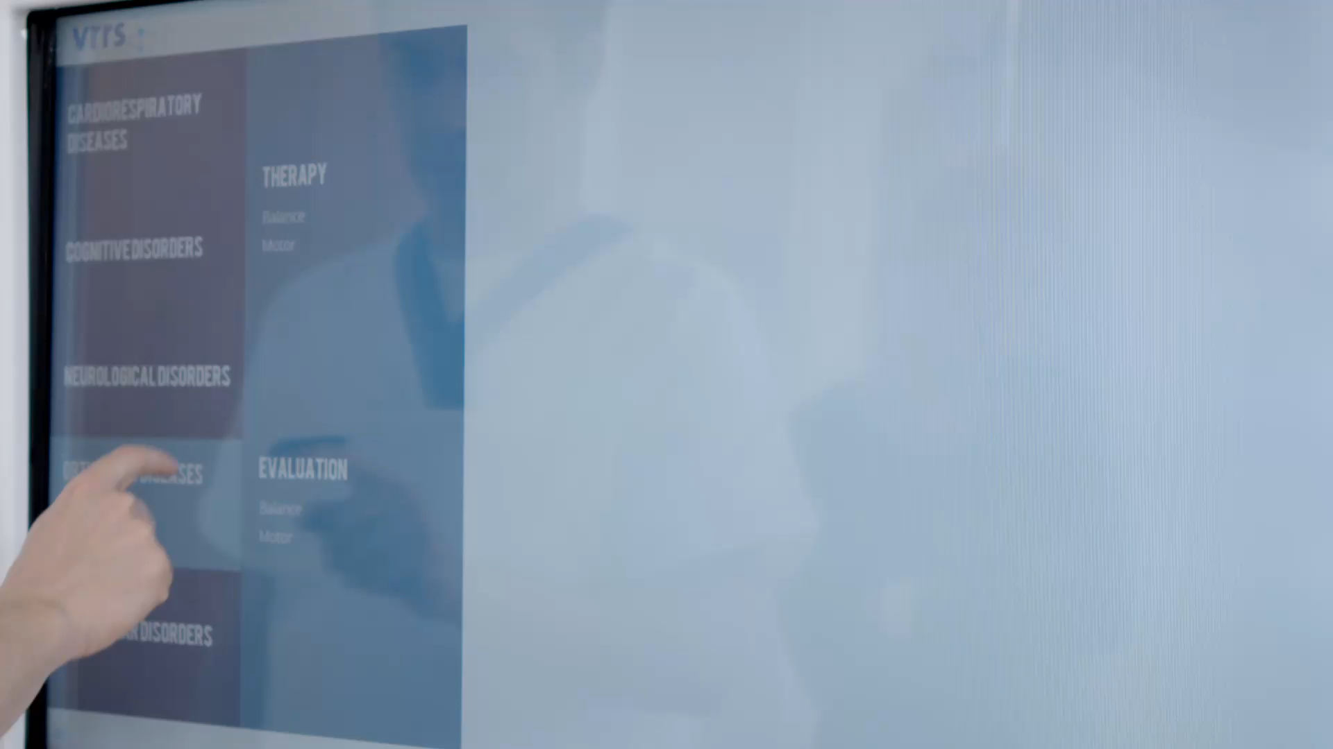
1000+ exercises.
.
Featuring more than 1000 clinically tested in both immersive and non-immersive scenarios, with audio and visual biofeedback.
All exercises feature a compensation indicator and an integrated virtual assistant for real-time patient guidance.
Wide variety of both rehabilitation activities and assessments.
Exercises are fully customizable to meet individual patient needs and can be organized into structured clinical protocols.
The built-in scoring system can be modulated in relation to the patient's residual capacities, to further stimulate the execution of the activities.

Slide 12
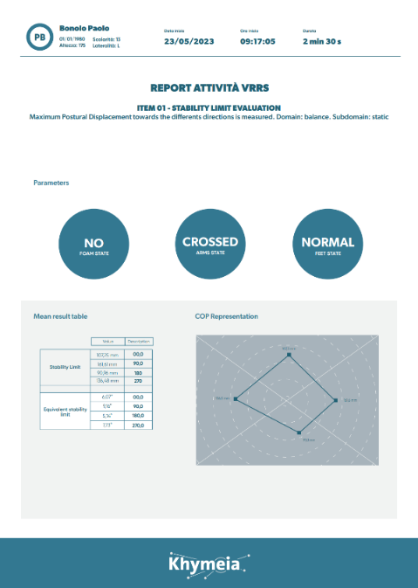
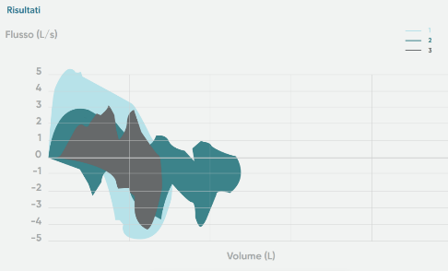
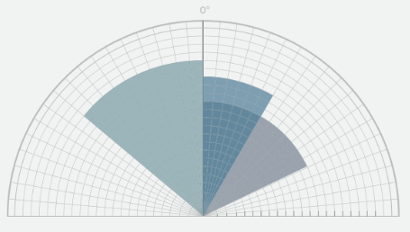
Reporting.
.
VRRS generates an automatic reporting system, fully integrated in real-time with the whole workflow of the patient rehabilitation session.
Data are available in any kind of format, included «raw data» for research purposes.

Slide 13
Scientific Validation.
Around 100 clinical publications and around 40 reviews, demonstrating effectiveness and feasibility of the VRRS and telerehabilitation on a wide range of conditions.
Neurological
Sensory-motor impairment | Acquired weakness
Incomplete cervical Spinal Cord Injury | Language disorders
Mild cognitive impairment (MCI) | Stroke
Severe Acquired Brain Injury patients | Chronic Pain
Myotonic dystrophy type 1 | Multiple sclerosis
TREM2-related dementia | Buccofacial apraxia
Chronic low-back pain | Congenital Hemiplegia
Facio-Scapulo-Humeral Muscular Dystrophy (FSHD) | Parkinson's Disease
Developmental
Adolescent With Motor Disorder
Developmental Coordination Disorder (DCD)
Dyslexia
Cerebral Palsy
Orthopaedic
Total hip arthroplasty
Total Knee Replacement
Respiratory
Post Covid
Notes:
More than 20 yrs of publications about the usage of VRRS Technologies, procucts, and methodologies.

Slide 14
^{Cognitive}
^{Rehabilitation}
^{Activities.}

Slide 15

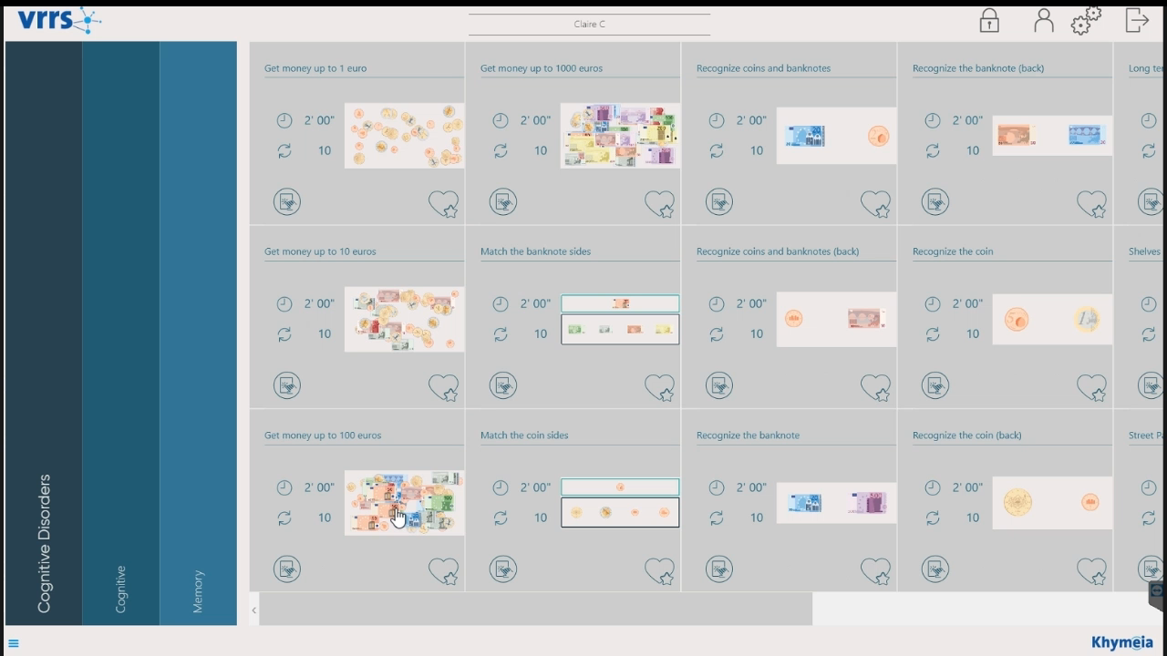
.
Cognitive.
The Cognitive Module enables activities to be performed via:
^{• Touchscreen}
^{• Touchscreen pen}
^{• Wearable sensors}
• Static and dynamic balance platform
Features auto-adaptive difficulty, dynamically adjusting based on patient performance.
^{• Praxical skills}
• Focused, sustained and divided attention
^{• Reaction time}
^{• Short- and long-term memory}
^{• Visuospatial processing}
^{• Temporal orientation}
• Executive functions (calculation, logic, sequencing and planning)

Slide 16
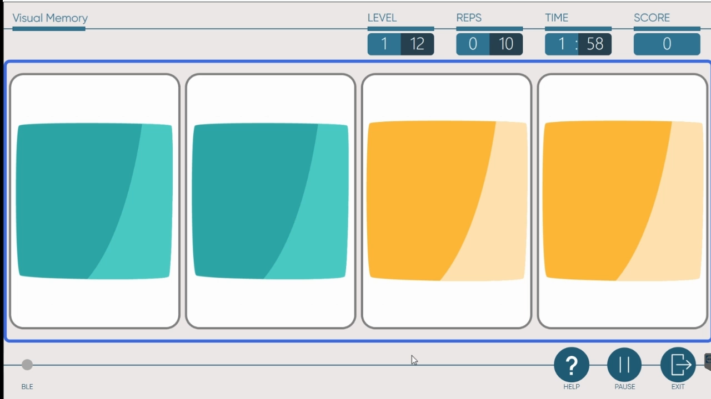
.
Cognitive.
This module is mostly used for the following rehabilitation practices:
^{• Mild Cognitive impairments}
• Alzheimer's Disease / Dementia
^{• Parkinson's Disease}
^{• Neglect}
^{• Spatial perception deficits}
• Post-stroke cognitive consequences
^{• Developmental disorders}
^{• Cerebral Palsy}

Slide 17
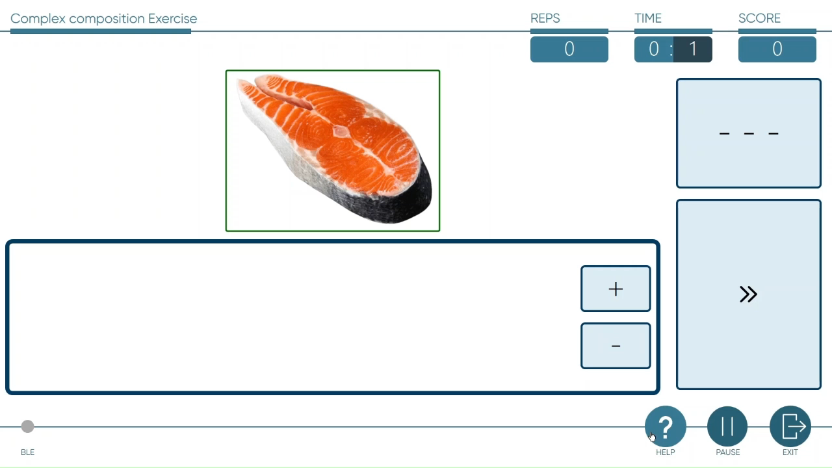
ª
^{B}
Speech Therapy.
^{ü}
.
The activities domains include:
^{• Phrase composition}
^{• Respiratory education}
^{• Written denomination}
^{• Writing}
• Rebuild the word (acoustic, textual, visual reference)
This module is mostly used for:
• Post stroke / TBI speech therapy
^{• Parkinson’s Disease}
^{• Developmental disorders}
^{• Cerebral Palsy}

Slide 18
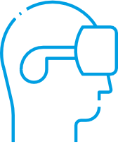
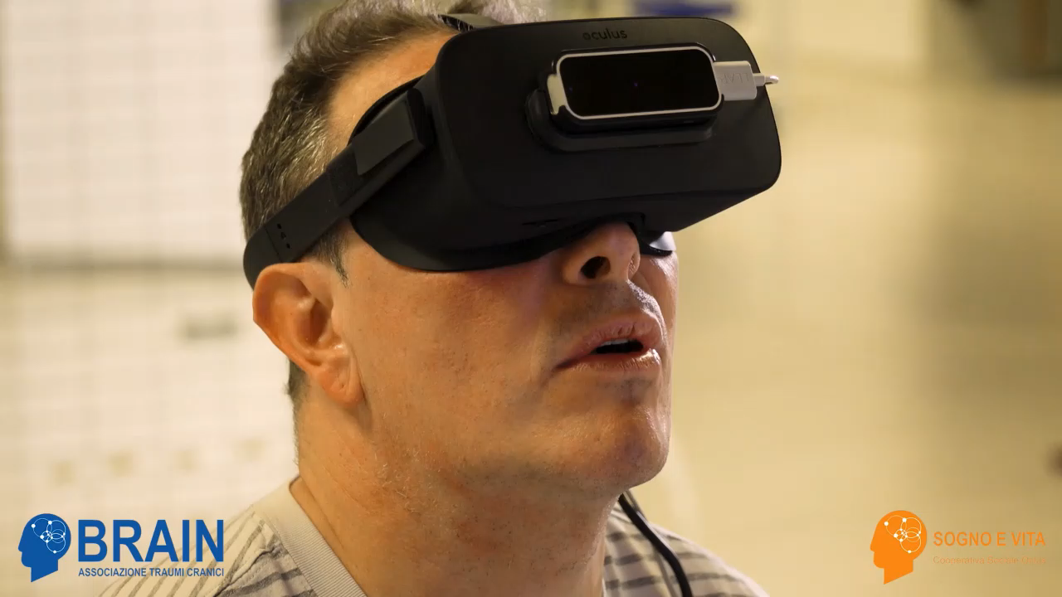
.
Full Immersive VR.
The exercises with full immersive VR rehabilitation are designed for the rehabilitation of fine hand movements, functional activities and ADL activities.
Among the other exercises, the patient will be able to use just his upper limb to move inside a supermarket to collect the items written in a shopping list.
This module is mostly used for:
^{• Post stroke and TBI}
^{• Multiple Sclerosis}
^{• Mild cognitive Impairment}
^{• Parkinson}
^{• Alzheimer}
^{and many others}

Slide 19

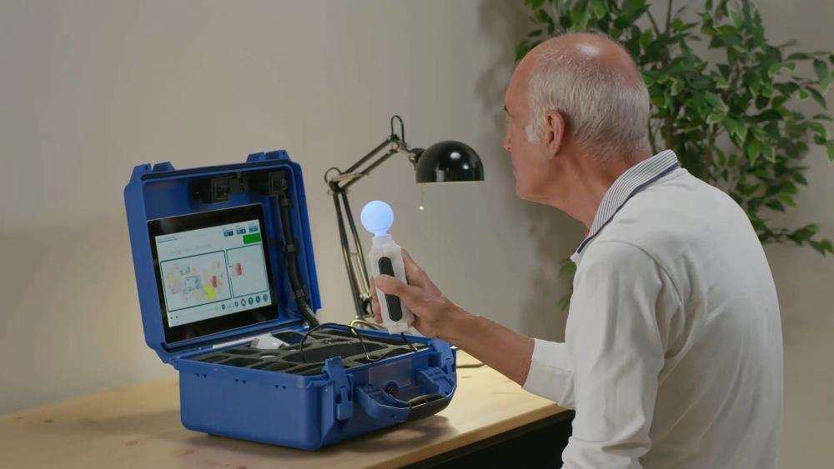
TELEREHAB.
Telerehabilitation
since 1998.
Since 1998, Khymeia offers the most complete and innovative Telemedicine and Telerehabilitation ecosystem for developmental and adult ages, managed through the “Kloud” platform, for a complete control over all its functions.
The implementation of the patented VRRS system has allowed the creation of territorial telerehabilitation networks, involving public and private institutions, offering an exclusive experience in the field of remote rehabilitation.
Notes:
Internationally published studies on VRRS Telerehabilitation have underlined:
an excellent clinical efficacy of the VRRS home telerehabilitation treatment;
increasing the intensity and duration of rehabilitation programs;
opportunities for continuous remote medical monitoring, especially for patients with severe acquired brain injury;
excellent compliance of the tele-rehabilitation technique also by elderly patients;
excellent cost / benefit ratio of home telerehabilitation for the patient;
promote the maintenance of the functional recovery obtained;
increase in the number of patients treated with the same available clinical resources.

Slide 20
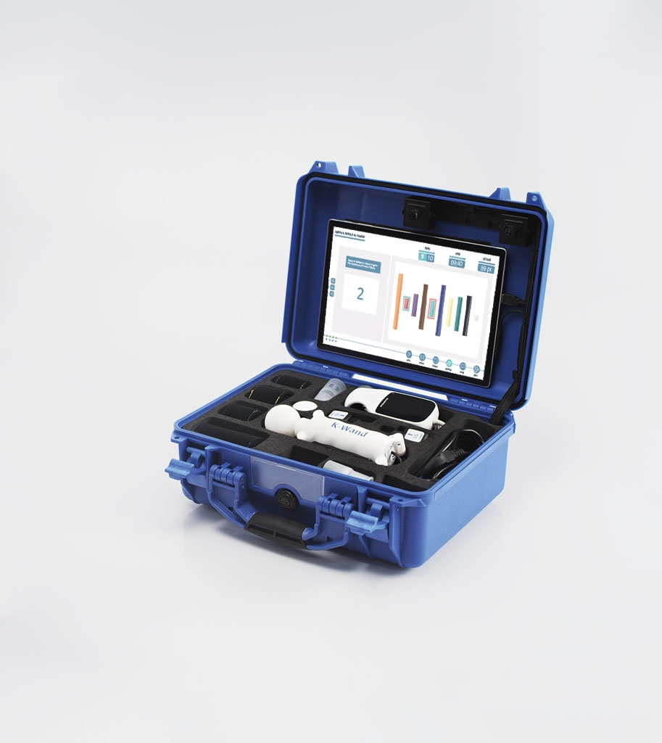

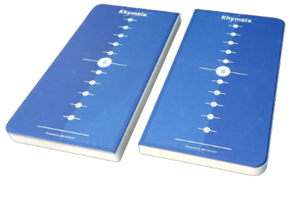
TELEREHAB.
HOME KIT
The HomeKit is the case that is delivered to the patient for home use, controlled by the Telecockpit.
^{HomeKit can be used in 2 ways:}
ONLINE the therapist takes possession of the case and interacts in real time with the patient, simultaneously viewing both the patient and what the latter is doing on the tablet.
OFFLINE the device is configured asynchronously by the therapist, with the rehabilitation program to be carried out at home autonomously, according to the programmed calendar. The integrated virtual assistant guides the patient throughout the execution of the exercises.
All patient activities, including offline ones, are recorded and made available to the Therapist.

Slide 21
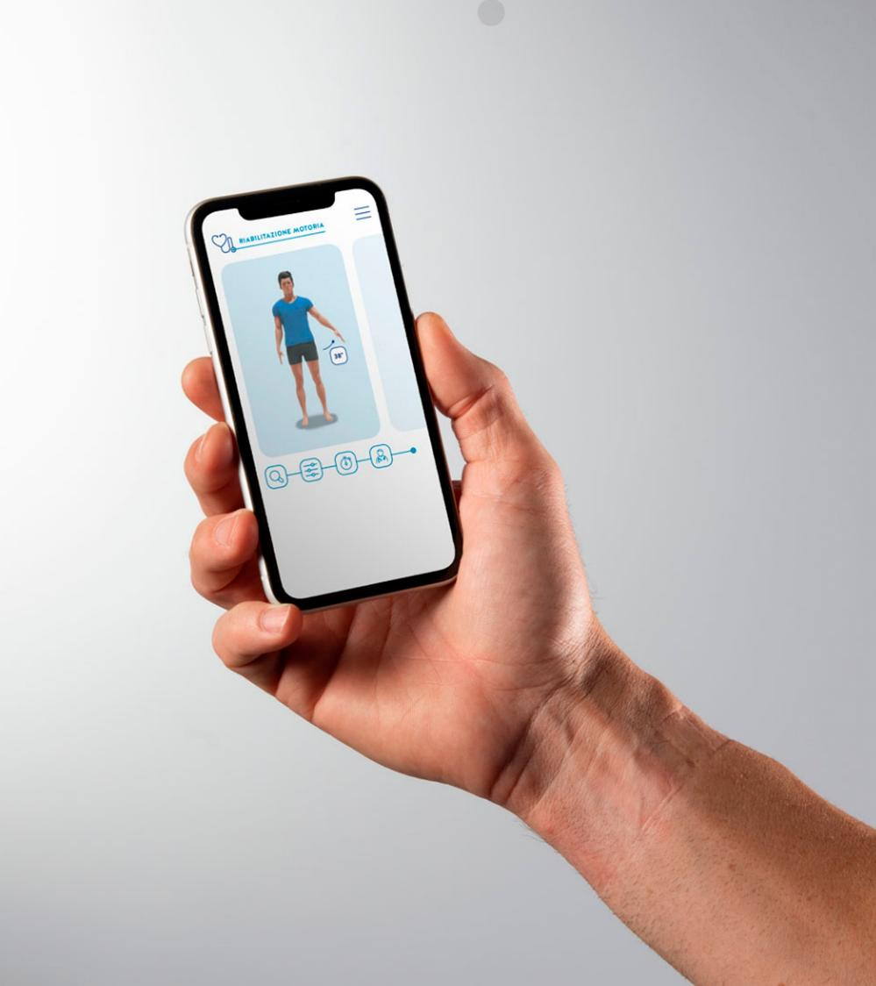

TELEREHAB.
MEDICO AMICO
The MEDICO AMICO app is the perfect solution to complete the overall tele-rehabilitation ecosystem, aiming to treat mild impairments keeping the patient’s follow-up always monitored.
The doctor/therapist invites the patient by email who authorizes the treatment. Then, the therapist delivers or even creates the rehabilitation protocol of the specific patient with the exercises based on video avatars.
MEDICO AMICO includes the modules Cognitive, Speech Therapy, Motor Skills and Orthopedic, and is available also with Inertial sensors.

Slide 22



^{Khymeia Group}
Via San Marco 11/C - NetCenter
^{35129 Padova – Italy}
^{info@khymeia.com}
^{khymeia.com}
^{khymeiaGroup}

Slide 23
